Slide 1
Critical Thinking
Lecture 6 Categorical Logic

Slide 2
Last Week
For any induction, each conclusion is probably derived from the premises.
In induction, the premises are inconclusive support to the conclusion.
The common patterns for induction include inductive generalization, statistical argument, predictive argument, causal argument, argument from authority, argument from analogy.

Slide 3
Arguments
Induction
Deduction
Common Patterns
Common Patterns
Categorical Logic
Truth and Validity
Inductive Strength

Slide 4

You will be able to…
Know what is categorical logic.
To translate the ordinary language into categorical statement.
To know the basic rules of categorical logic, including:
The square of opposition.
Categorical relations.

Slide 5
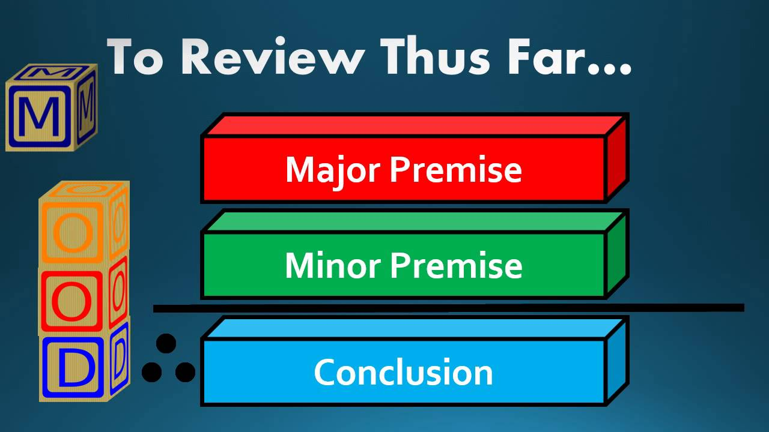
What is Categorical Syllogism?
Categorical syllogism:
Three-line argument
Categorical statement.
Categorical Statements:
Quantifiers: All, Some, No, Individual
Copula: is or are
Terms: set or class of things as subject and predicate.

Slide 6
What is Categorical Syllogism?
All human are mammals.
All mammals are animals.
All human are animals.
∴
Quantifiers
Copula
Terms

Slide 7
Four types of categorical statements
A-form: All S are P
All Johorians are Malaysians.
Mr. Tan is Malaysians.
Only Malaysians are Johorians
If anyone is Johorians, then she is a Malaysians.
Etc.
Every S is a P. | Whoever is an S is a P.
Whatever is an S is a P. | Any S is a P. Each S is a P.
If anything is an S, then it is a P. | If something is not a P, then it is not an S.
Only if something is a P is it an S. | Something is an S only if it is a P.
Only P are S. | The only S are P.
S are always P. | S are all P.

Slide 8
Four types of categorical statements
E-form: No S are P.
No Malaysians are terrorisms.
No terrorisms are Malaysians.
All Malaysians are non-terrorisms.
If anyone is Malaysian, then she is not a terrorism.
Etc.
No P are S.
S are not P.
Nothing that is an S is a P.
No one who is an S is a P.
None of the S are P.
Not a single S is P.
If anything is an S, then it is not a P.
All S are non-P.

Slide 9
Four types of categorical statements
I-form: Some S are P.
Some SUC students are Johorians.
Many SUC students are Johorians.
Most SUC students are Johorians.
Etc.
Some P are S.
A few S are P.
There are S that are P.
Several S are P.
Many S are P.
Most S are P.
Nearly all S are P.
S are sometimes P.
Fifty percent of S are P.
S are occasionally P.

Slide 10
Four types of categorical statements
O-form: Some S are not P.
Some SUC students are not Johorians.
Not every SUC students are Johorians.
Most SUC students are not Johorians.
Some SUC students are non-Johorians.
Not all S are P.
Not everyone who is an S is a P.
S are not always P.
There are S that are not P.
A few S are not P.
Many S are not P.
S are hardly ever P.
Hardly any S are P.
Few S are P.

Slide 11
Translating Ordinary Language
Ordinary Language | Language of Categorical Logic | Categorical Statements
All students come to school by car. | All students are the people who drive car to school. | A
All lecturers do not involve JJPTR. | No lectures are the investor of JJPTR. | E
Thousand of investors may lost the money. | Some investors are the people who lose the money. | I
Some students are absent. | Some students are the people who are not in the classroom. | O

Slide 12
Translating Ordinary Language
Remarks 1: Rephrase all nonstandard subject, predicate and verbs.
All actors are vain.
Into:
All actors are vain people.
Some rose are white.
Into:
Some rose are white flowers.
Some students walk to school.
Into:
Some students are persons who walk to school.
The subject and predicate must refer to categories or classes!
The verbs must be copula!

Slide 13
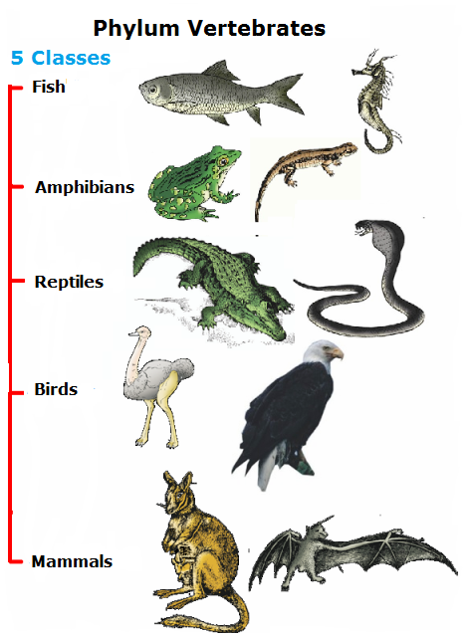
Translating Ordinary Language
Remarks 2: Fill in any unexpressed quantifiers.
Crocodiles are not amphibians.
into:
No crocodiles are amphibians.
Politicians are conservatives.
Same with:
Some politicians are conservatives.
To interpret the intention charitably!

Slide 14
Translating Ordinary Language
Remarks 3: Translate Single (Individuals) Statements into A or E
Socrates is mortal.
Into:
All people identical with Socrates are mortal.
No people identical with Socrates are immortal.
Mr. Tan is the lecturer of Critical Thinking.
Into:
All people identical with Mr. Tan are the lecturer of Critical Thinking.
No people identical with Mr. Tan are not the lecturer of Critical Thinking.

Slide 15
Translating Ordinary Language
Remarks 4: Equivalent statements
Everyone who is fail in English Placement Test must take English 1.
Same with:
No students who are required to take English 1 pass in English Placement Test.
All humans are rational animals.
Same with:
All rational animals are humans.
How about “all students of SUC are Johorians”, “all human are animals”?
The members of subject and predicate are interchangeable if they have same categories or classes!

Slide 16
Translating Ordinary Language
Remarks 5: Other Stylistic Statements as A
If the car is out of gas, then it won’t start.
Into:
Every car which is out of gas is unable to start.
Whoever is a bachelor is a male.
Into:
All bachelor are male.
Mary is loved by Albert.
Into:
All people identical with Albert are the people who loves Mary.

Slide 17
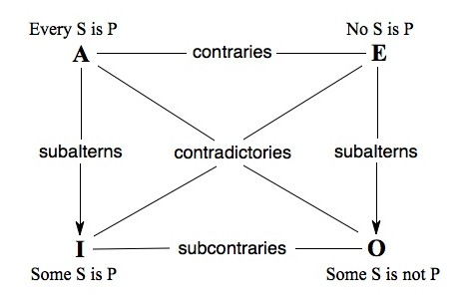
Square of Opposition
Inferring from one categorical statement to another:
Contradiction
Contrary
Sub-contrary

Slide 18
Square of Opposition
Contradictories:
Never true or false at the same time.
A contradict to O; E contradict to I:
All man are mortal vs. Some man are not mortal
Some students are not nerd vs. All students are nerd
No students are E.T. vs. Some students are E.T.
Some people are right-handed vs No people are right-handed.

Slide 19
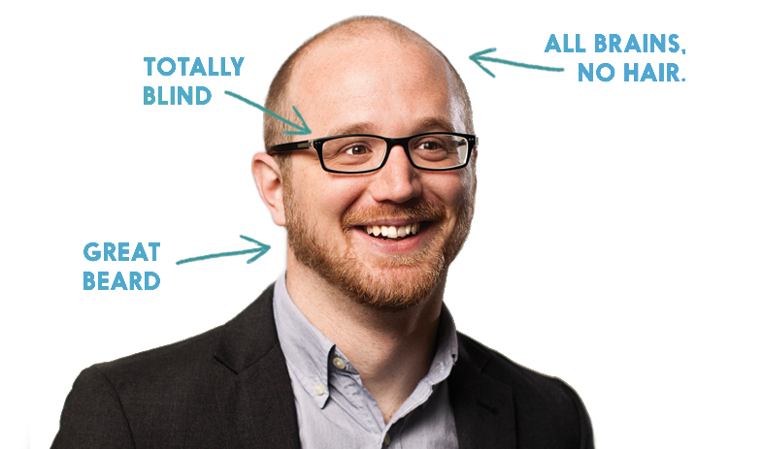
Square of Opposition
Contraries:
Can both be false, but cannot both be true
A contraries to E:
All human are mortal vs. No human are mortal
All students are nerd vs. No students are nerd
All students are Johorians vs. No students are Johorians
Nerd

Slide 20
Square of Opposition
Sub-contraries:
Can both be true, but cannot both be false
I sub-contraries to O:
Some politicians are conservative vs. Some politicians are not conservative.
Some snake are harmless vs. Some snake are not harmless.
Some Malaysians are Johorians vs. Some Malaysians are not Johorians.

Slide 21
Categorical Relations (Optional)
Conversion (Only for E and I)
E and I can converse with each other.
No animals are stones = No stones are animals
Some students are Johorians = Some Johorians are students
A and O can not converse with each other.
All Johorians are Malaysians ≠ All Malaysians are Johorians.
Some Malaysians are not Johorians ≠ Some Johorians are not Malaysians.

Slide 22
Categorical Relations (Optional)
Obversion
Changing from affirmative to negative, or vice versa;
Replacing the predicate term with its complementary term.
A, E, I and O are equivalent to their obverses.
All Johorians are Malaysians = All Johorians are not non-Malaysians.
No animals are stones = No animals are not non-stone.
Some students are Johorians = Some students are not non-Johorians.
Some Malaysians are not Johorians = Some Malaysians are non-Johorians.

Slide 23
Categorical Relations (Optional)
Contraposition (Only for A and O)
Switching the subject and predicate terms;
Replacing both terms with complementary terms.
A and O are equivalent to their contrapositives.
All Johorians are Malaysians = All non-Malaysians are non-Johorians.
Some Malaysians are not Muslims = Some non-Muslims are not non-Malaysians.

Slide 24
Concluding Remarks
Categorical syllogism is a three-line argument, consisting three terms and logical quantifiers
There are four types of categorical statements: A, E, I, O
All categorical statements can be inferred from one to another in three logical relation: contradiction, contrary and sub-contrary.

